Slide 1



BMW SALES REPORT
View in Power BI
Last data refresh:
07/09/2024 22:01:00 UTC
Downloaded at:
07/09/2024 22:08:01 UTC

Slide 2
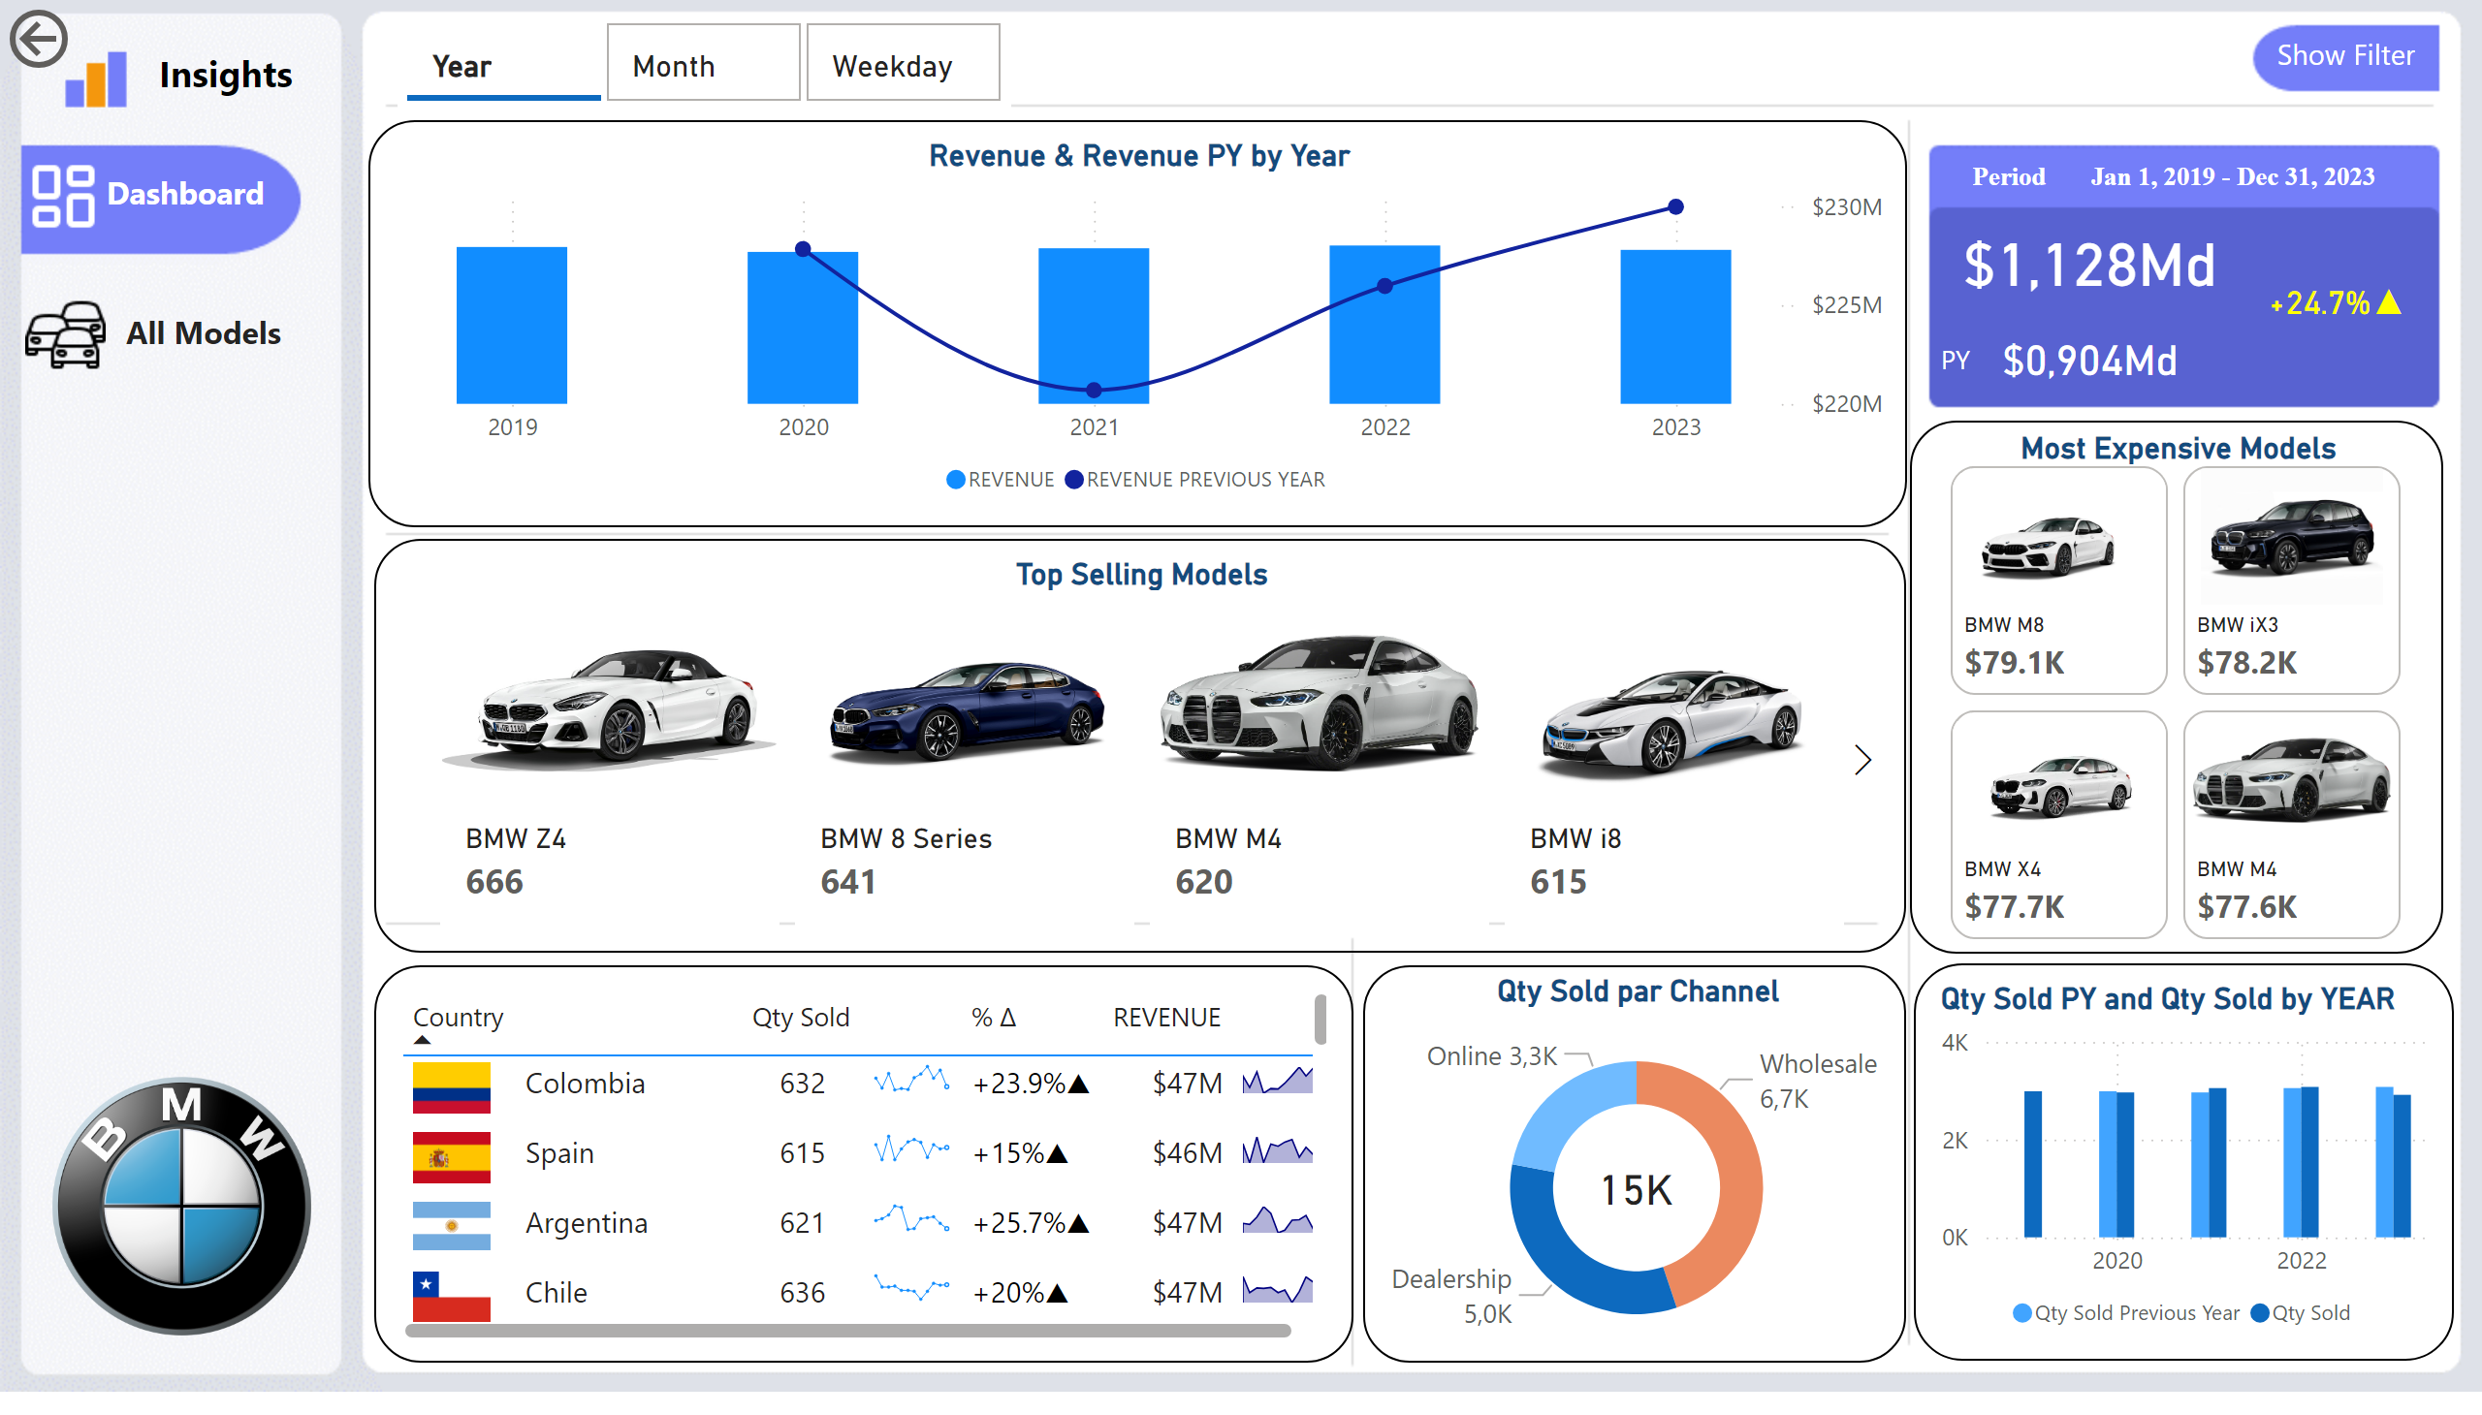
Page 1
Notes:
card
No alt text provided
card
No alt text provided
textbox
No alt text provided
textbox
No alt text provided
card
No alt text provided
actionButton
No alt text provided
Top Selling Models
No alt text provided
Most Expensive Models
No alt text provided
Qty Sold PY and Qty Sold by YEAR
No alt text provided
donutChart
No alt text provided
card
No alt text provided
tableEx
No alt text provided
textbox
No alt text provided
image
No alt text provided
image
No alt text provided
textbox
No alt text provided
actionButton
No alt text provided
advancedSlicerVisual
No alt text provided
Revenue & Revenue PY by Year
No alt text provided
actionButton
No alt text provided
shape
No alt text provided
slicer
No alt text provided
slicer
No alt text provided
slicer
No alt text provided
slicer
No alt text provided
actionButton
No alt text provided
slicer
No alt text provided
actionButton
No alt text provided
actionButton
No alt text provided
image
No alt text provided
image
No alt text provided
textbox
No alt text provided

Slide 3
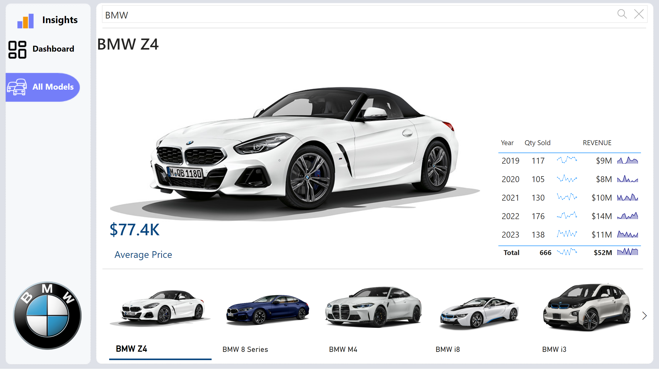
Page 2
Notes:
textSearchSlicerF85E2E78BE4A4D7D9F99ED75B5D71C85
No alt text provided
Top Selling Models
No alt text provided
Top Selling Models
No alt text provided
textbox
No alt text provided
shape
No alt text provided
shape
No alt text provided
tableEx
No alt text provided
textbox
No alt text provided
image
No alt text provided
image
No alt text provided
actionButton
No alt text provided
image
No alt text provided
image
No alt text provided
textbox
No alt text provided
textbox
No alt text provided

